Slide 1
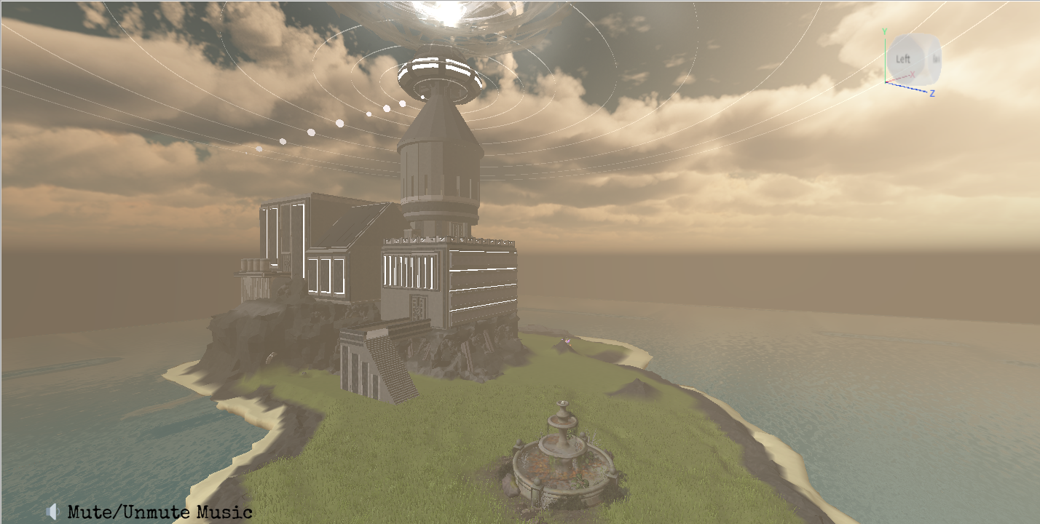
ROBLOX PROJECTS

Slide 2
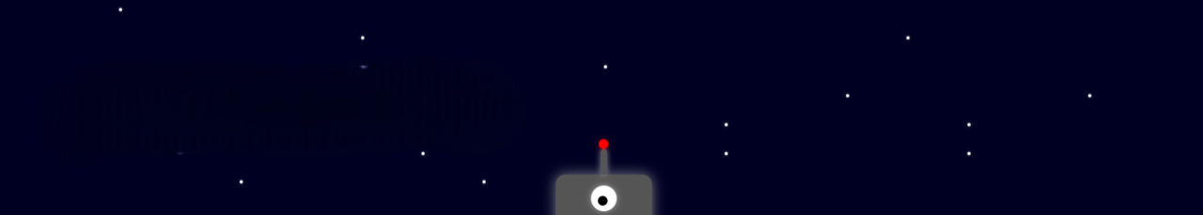
SAMUEL CHEUNG

Slide 4


Slide 5


Slide 6
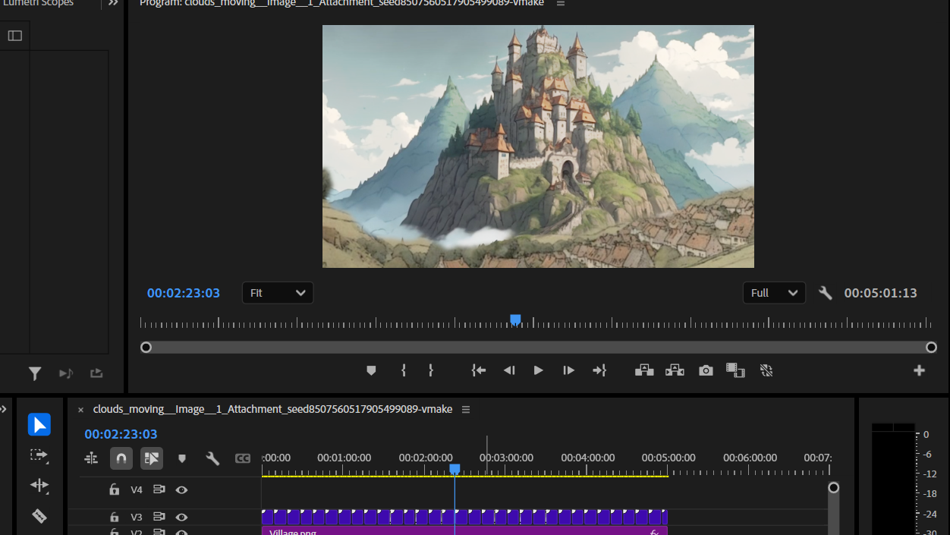
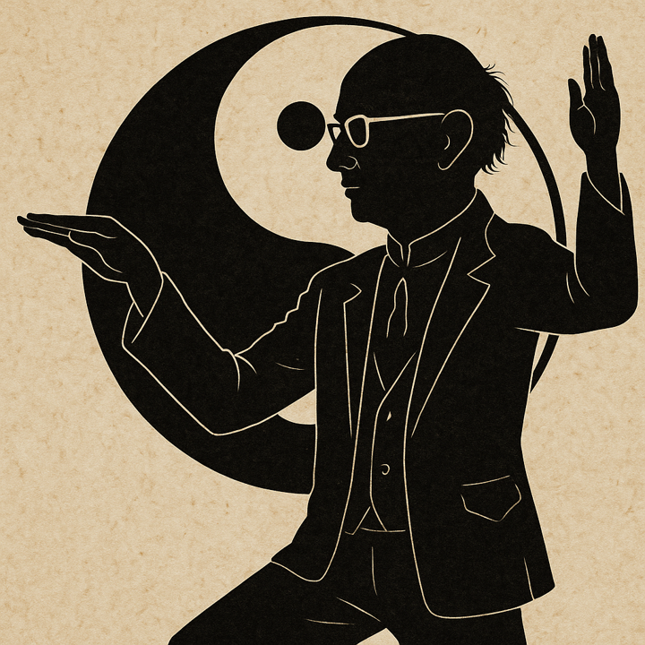
ANIMATED BACKGROUNDS

Slide 7

AVID MEDIA COMPOSER
VIDEO EDITS

Slide 8


Slide 9
